Slide 1
TECHNICAL WRITING
WEEK 1
INTRODUCTION
WRITING THAT’S EASY TO READ IS ALWAYS EASIER TO UNDERSTAND.

Slide 2
DAY 1
Course Outline
Student Code of Conduct
Course Calendar
Technical Writing – quick review

Slide 3
COURSE GOALS
Develop effective writing skills that can then be used as a tool for clear communication:
  Writing as a process or formula
  Mechanics
    Sentence structure
    Grammar
    Punctuation
    Spelling
The measure of a successful document is how well the audience is able to understand the information presented, and then how well that understanding fulfills the intended purpose of the work.

Slide 4
TECHNICAL WRITING
Many jobs require strong writing skills
All written communication has a purpose and is intended to accomplish something for the organization
Text must clearly convey knowledge to the reader
Tech writing requires you know who the readers will be and why they need the document

Slide 5
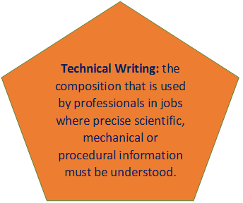
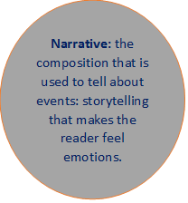
TECHNICAL WRITING VERSUS COMPOSITION

Slide 6
QUESTIONS TO ASK YOURSELF
As you prepare a presentation or a piece of writing, ask yourself:
1. Why am I writing this, what is my purpose?
    Inform?
    Instruct?
    Recommend?
    Request?
2. Who is my audience?
    Who will read the document? What is their position in the company?
    How much time do they have?
Audience analysis is crucial to creating well-crafted technical documents.

Slide 7
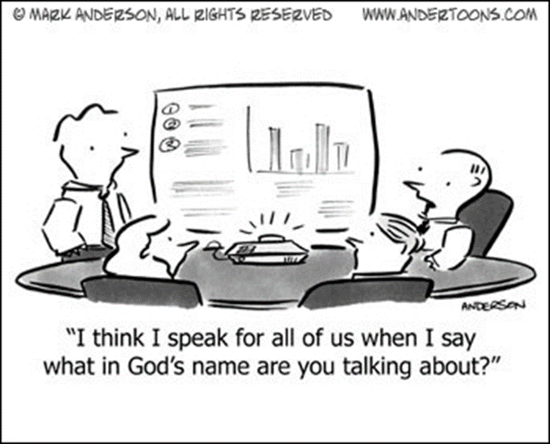
THE BASICS…
1) Types of Technical Writing
2) Traits of Technical Writing
3) Steps of Technical Writing

Slide 8
1) TYPES OF TECHNICAL WRITING
Correspondence (letters, emails, memos)
User’s Manuals
Proposals
Descriptions & Instructions
Processes
Problem Analysis, Evaluation & Recommendations
Lab/Reports
Presentations & Proposals
Web Pages, Brochures, Fliers
Policies & Procedures

Slide 9
2) TRAITS OF TECHNICAL WRITING
a) Clarity
b) Conciseness
  c) Accessible document design
d) Audience recognition
e) Accuracy
  The rule of thumb is “KISS” – Keep It Short and Simple
  BUT make sure the necessary information is included.
Gerson, Dr. Steven M. Writing That Works (http://www.ksde.org)

Slide 10
a) Clarity
Information must be clear & concise. Specificity is achieved through details.
Clarity is achieved by asking:
Who – is the audience?
What – do you need them/want them to know?
When – is the deadline?
Why – does this need to be done (rationale)?
How – should it be done?

Slide 11
b) Conciseness
Use short words and short sentences whenever possible but ensure the necessary logical relationships are made clear in the text
Include only the information the audience needs
Help the reader understand the message
Change long words to short words:
    cognizant know
    endeavour try
    Utilize use

Slide 12
c) Accessible Document Design
Organization must be made explicit in headings and layout design.
Use the following techniques to create a well-crafted document:
    Graphics (tables & figures)
    White space
    Boldface text
    Headings/subheadings

Slide 13
d) Audience Recognition For Technical Documents
  Laymen. Non-specialist readers who lack background (knowledge or experience) in the subject matter of the technical document.
  Technicians. Readers who have or need background required to assemble, operate, maintain, or repair equipment, or to run complex processes.
  Executives. Readers who may not have much technical background but who use technical information to make decisions: to purchase, sell, implement, regulate, etc.
  Experts. Readers who have in-depth knowledge about the technology-its design, construction, uses, operation, as well as the theory behind it.

Slide 14
e) Accuracy
Observe the conventions of grammar, spelling, punctuation, and form
I have a spelling checker,
It came with my PC.
It plainly marks four my revue
Mistakes I cannot sea.
I’ve run this poem threw I,
I’m sure your pleased to no
It’s letter perfect in it’s weigh
My checker tolled me sew.
Check spelling
Let it sit
Ask someone else to read it, if time allows
Read it out loud

Slide 15
Successful Writing Tips
SmartTeamU, successfully demonstrates why knowing your audience is relevant. Go to:
http://www.youtube.com/watch?v=uZbv7bwcKNw

Slide 16
3) The Steps Of Writing
Pocket Guide
The Writing Process
A Purpose Statement a) PURPOSE
Consider Obstacles
Technical Level b) AUDIENCE
Decision Making Level
What the Decision Maker wants c) SCOPE
Collect information d) RESEARCH
Write an Outline
Write a draft
Revise in stages e) CREATE IMPACT

Slide 17
a) Purpose
You may be told what your document is supposed to do, but there will be times you will be required (or it will be in your best interest) to generate your own objective and documents.
Ask yourself:
Why are you writing?
  Technical documents have two goals: to inform readers and to persuade readers.
How is the document supposed to inform and educate the reader?
What do you want the document to achieve?

Slide 18
b) Audience
Who will read your text? What is their position in the company?
How much time do they have?
What do they need to know?
What will they understand?
Who will be able to act on it and who will have to react to it?

Slide 19
c) Scope
Your scope is defined when you match the purpose with the audience:
  It describes the ground covered by the report and outlines the method of investigation used in the project.
  It reflects what needs to be communicated and to whom?

Slide 20
d) Research
May require you consult other documents which you must reference:
    Quote
    Paraphrase
    Summarize
May require you understand the person/business:
    What do you know about them?
    Consult with others who have communicated with the person/business
May require you work with people in far away places:
    How will you communicate?
    How will you share ideas (don’t be a dictator!)?

Slide 21
e) Create Impact
Write an Outline
    Brainstorm ideas
    Sort, organize, and structure
Organize Logically
    Emphasis on Importance
    Show relationships
    Identify key points
    Use sub-headings
Revise in stages
    Content
    Style
    Grammar
    Mechanics

Slide 22
In a Nutshell
Your communication, no matter the form, is designed to provoke a reaction.
To get results you must smoothly, logically, and concisely, bridge the gap between what you know and what your audience knows.

Slide 23
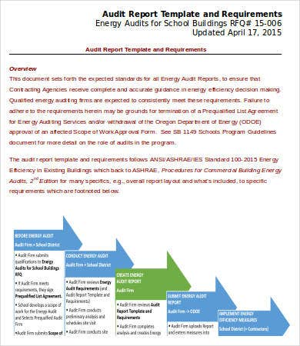
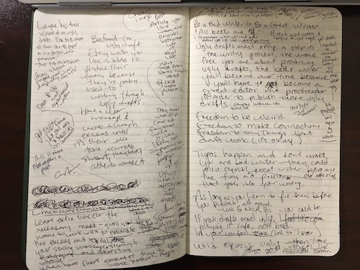
Mechanical Insights
https://copyblogger.com/bad-writer/
Rough Draft
Good Copy

